Slide 1
COMMERCE –III ( MF)
DR.SUMITA SHANKAR

Slide 2
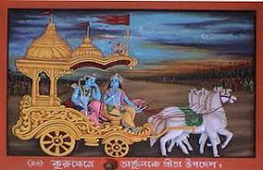
Significance of Indian Ethos to Management

Slide 3
WHAT IS ETHOS ?
Ethos is derived from Greek which means “ Character “ or Fundamental values
Ethos are the moral ideas and attitude that belong to a particular group or society or country.
Indian wisdom brought forth in Bhagavad Gita, Veda , Upanishads and Puranas

Slide 4
Examples from past.
Kautilya – Arthshashtra – 321 BC
Administration of Cities like Mohenjo-Daro and Harappa of ancient Aryans in 2000 B.C
Gautam Buddha's order and Sangh in 530 B.C
Bhagavat Gita
Ram Rajya
Rishi ( Saint)
Mahatma Gandhi

Slide 5
Current trend in Indian Management
Grow with the pace of WEST and grace of EAST

Slide 6

1. Holistic Approach

Slide 7

2. Karma Yoga

Slide 8
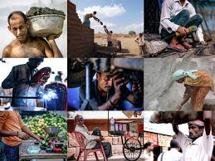
3.Dignity of Work

Slide 9

4. Individual Development

Slide 10

5. Self Sacrifice

Slide 11

6. Service Attitude

Slide 12

7. Empathy

Slide 13

8. Respect

Slide 14
THANK YOU

